Slide 1
Meeting 3
Xueyin LUO

Slide 2
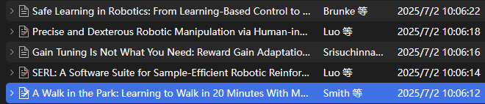
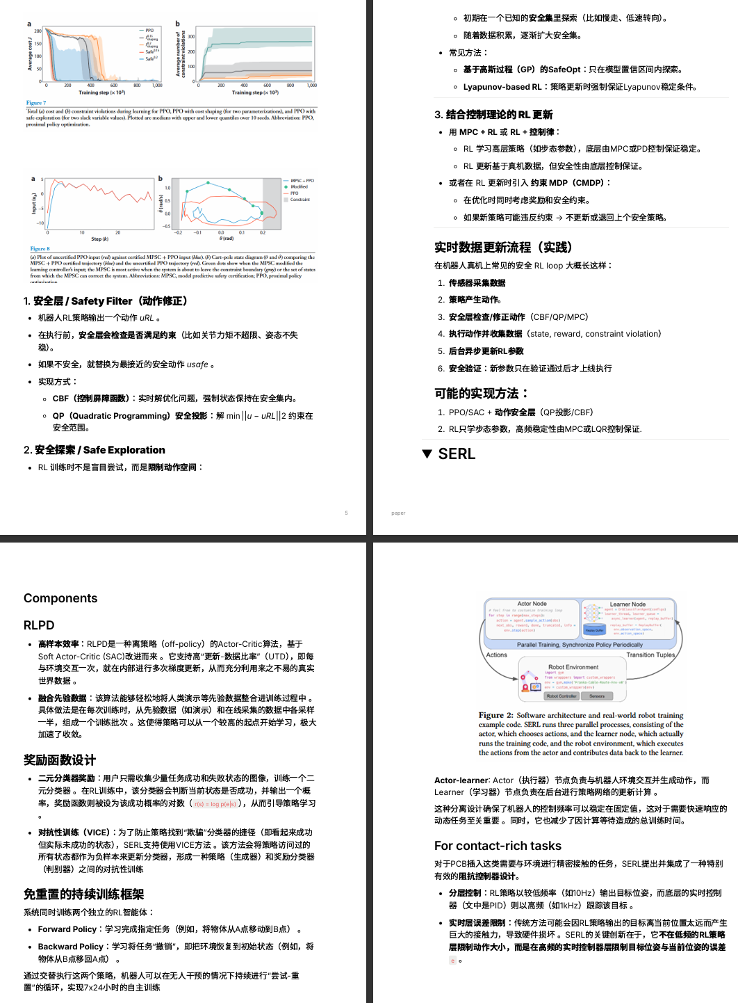
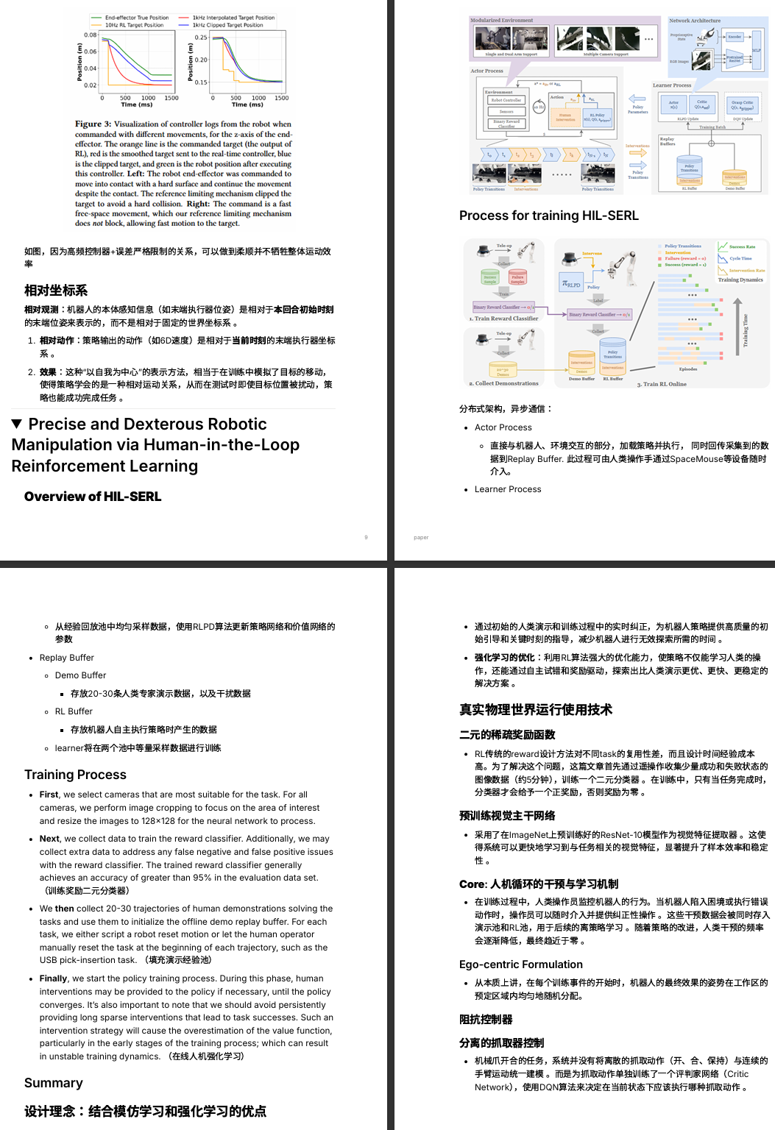
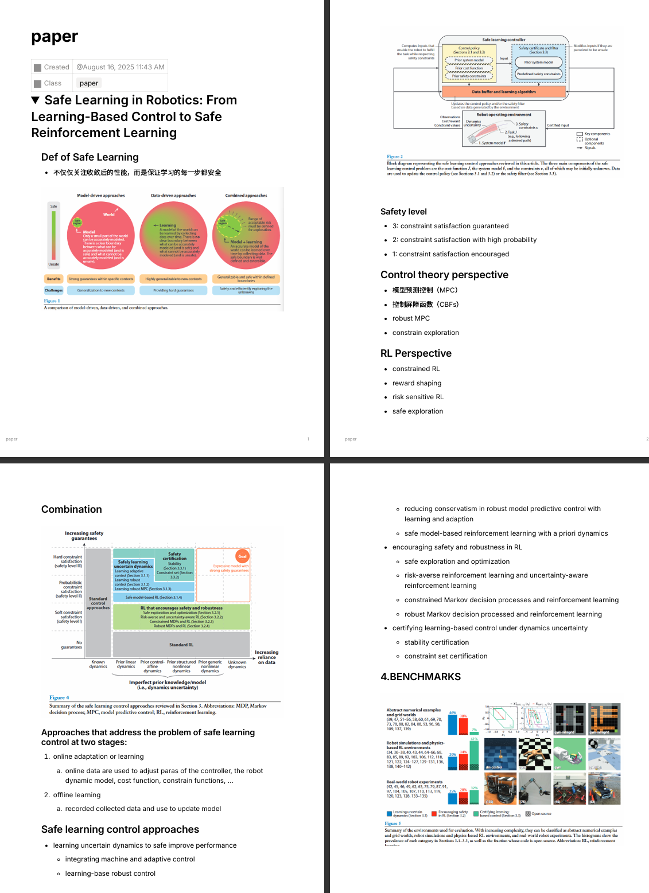
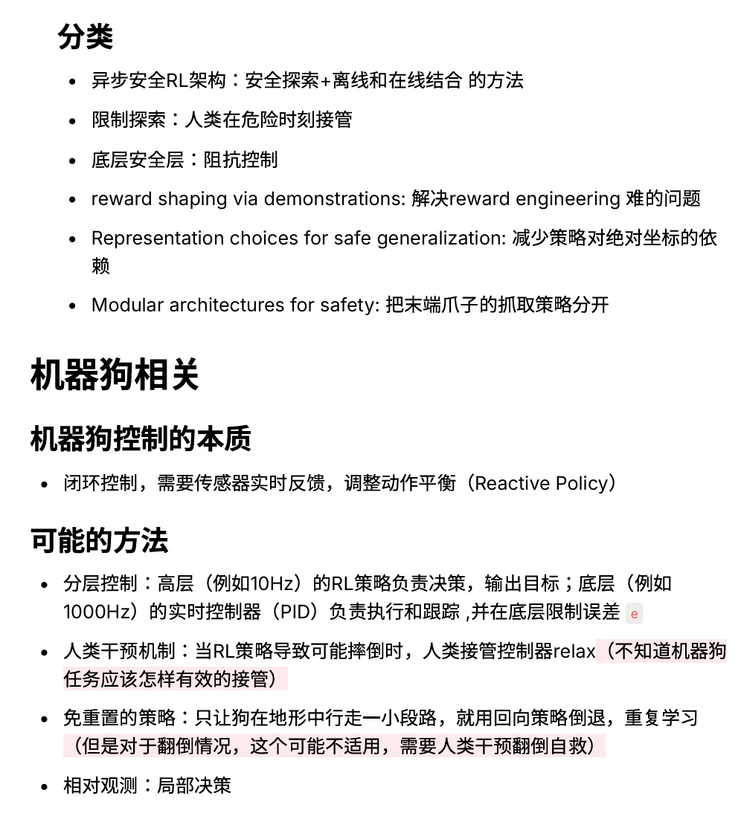
8.15-8.17
Read Essays about Online Learning of RL, summarize workflow and possible implementing ways

Slide 3
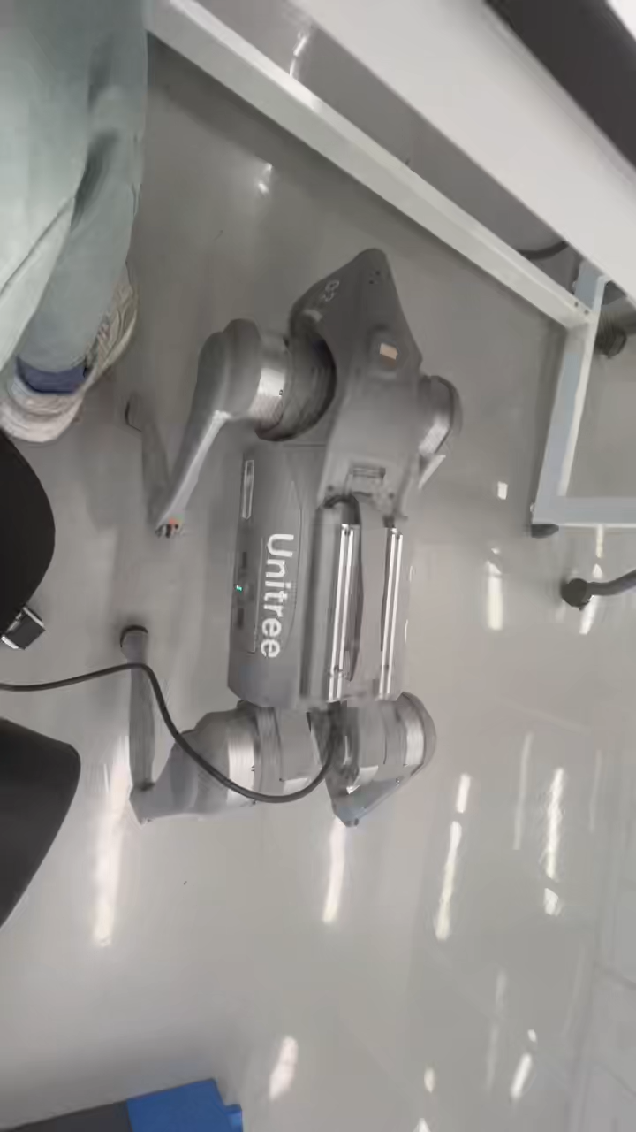
8.17-8.22
Deploy policy on real-world robot
Unitree go2 SDK test
Modify deploy_real for go2, 0 filled for missing Vy in real world

Slide 4
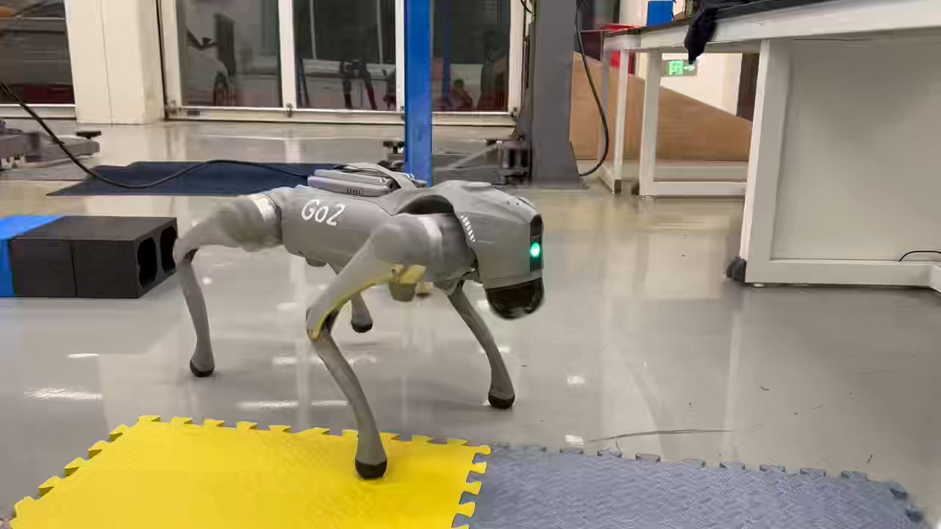
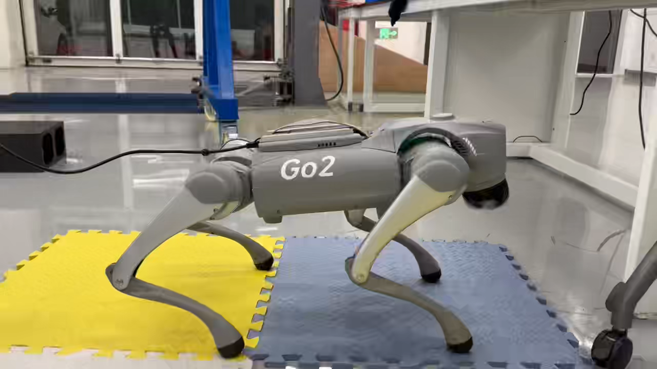
8.17-8.22
Deploy policy on real-world robot
Unitree go2 SDK test
Modify deploy_real for go2, 0 filled for missing Vy in real world

Slide 5
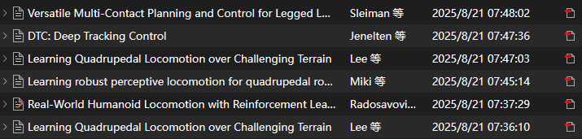
8.23-8.28
Because Online Learning is hard to implement at current stage, we want to implement RL with perception first.
Currently, I’m reading and analysising workflows of essays mentioned below:

